Slide 1
Predicting US Corn Prices
Bailey Cameron
Richa Dudani
Shuran Xu
Zeldi Snyman
Notes:
Introduce team members
We decided to look at the impact of weather on the price of commodities. This is so interesting, because weather is so unpredictable, so we chose weather as a feature to forecast the price of corn. The findings were very interesting and we are here to show you what we did and what our results were.

Slide 2
Approach followed
06
Algorithmic Trading
05
Linear regression analysis: Daily and Monthly
04
Machine Learning - XGBoost
03
Weather data analysis and dashboard - Pyviz and Panel
02
Research and data extraction
Time series analysis: Arima and Sarima
01
Notes:
This slide summarises our approach which we will delve into more detail through the course of the presentation

Slide 3
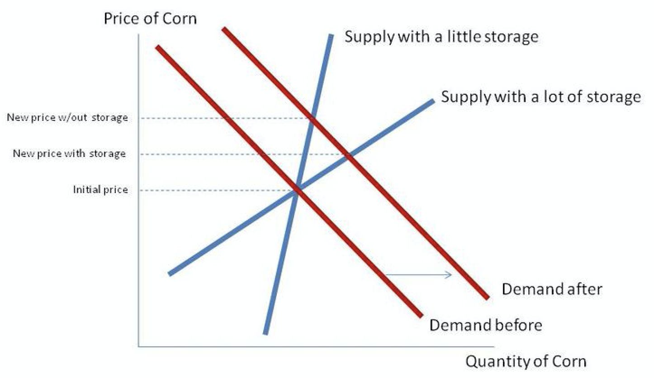
Research
US is the dominant corn exporter with a two-thirds share of world markets
Corn Macro-economics:
Supply:
stock at hand
production
imports
Demand:
animal feed
ethanol production
exports
food
Corn production is highly impacted by Weather
Seasonal tendencies
Notes:
We initially investigated 4 commodities, corn, cocoa, sugar and soy and decided to use Corn due to the fact that its the most
Dominant grain grown in the world
The US is leading producer and top consumer of corn worldwide and is traded on the Chigago Board of Exchange - so this made our data journey easier, limiting it to the states
Corn plays an important role in the global economy and as most of you have learnt in Economics 101, the price of commodities is based on Supply and demand
On the supply side, you have stock in storage, production and imports
On the demand side, it is used for exports, animal feed, food and roughly 40% is used for ethanol production
Weather plays an important role in crop production. This is especially true in regard to planting and harvest dates, both of which impact the total size of the crop
Late June or early July - corn hits yearly peak prices with high volatility
November - harvest time - corn hits yearly lowest price, thereafter during winter corn prices has least volatility

Slide 4
Data extraction
Dates: Jan 2000 - Dec 2019
Weather data:
Extracted min, max and precipitation
US Corn price
China Imports
China Inflation Rates
US Inflation Rates
Ethanol futures
USD Index
Notes:
US Corn price - www.macrotrends.net
Ethanol futures - YahooFinance API
USD Index - YahooFinance API
China Imports - www.indexmundi.com
China Inflation Rates - www.inflation.eu
US Inflation Rates - www.usinflationcalculator.com

Slide 5
Weather analysis
Extraction Process:
Corn belt states: Illinois, Indiana, Nebraska, Ohio, Iowa

Slide 6
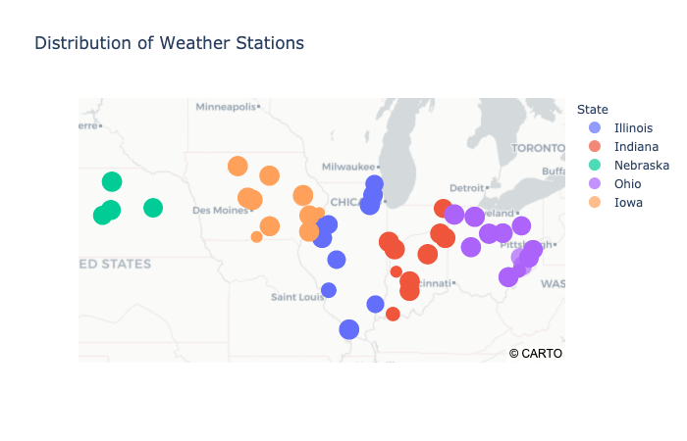
Weather analysis
Extraction Process:

Slide 7
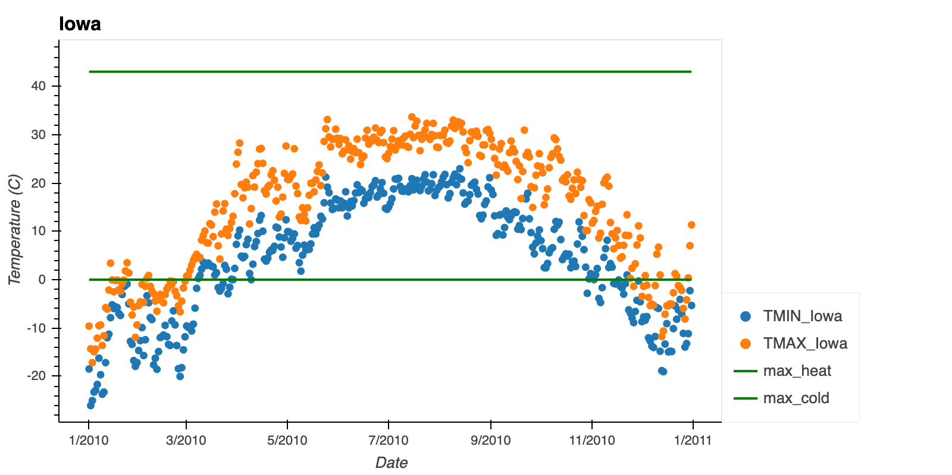
Weather analysis
Analysis:

Slide 8
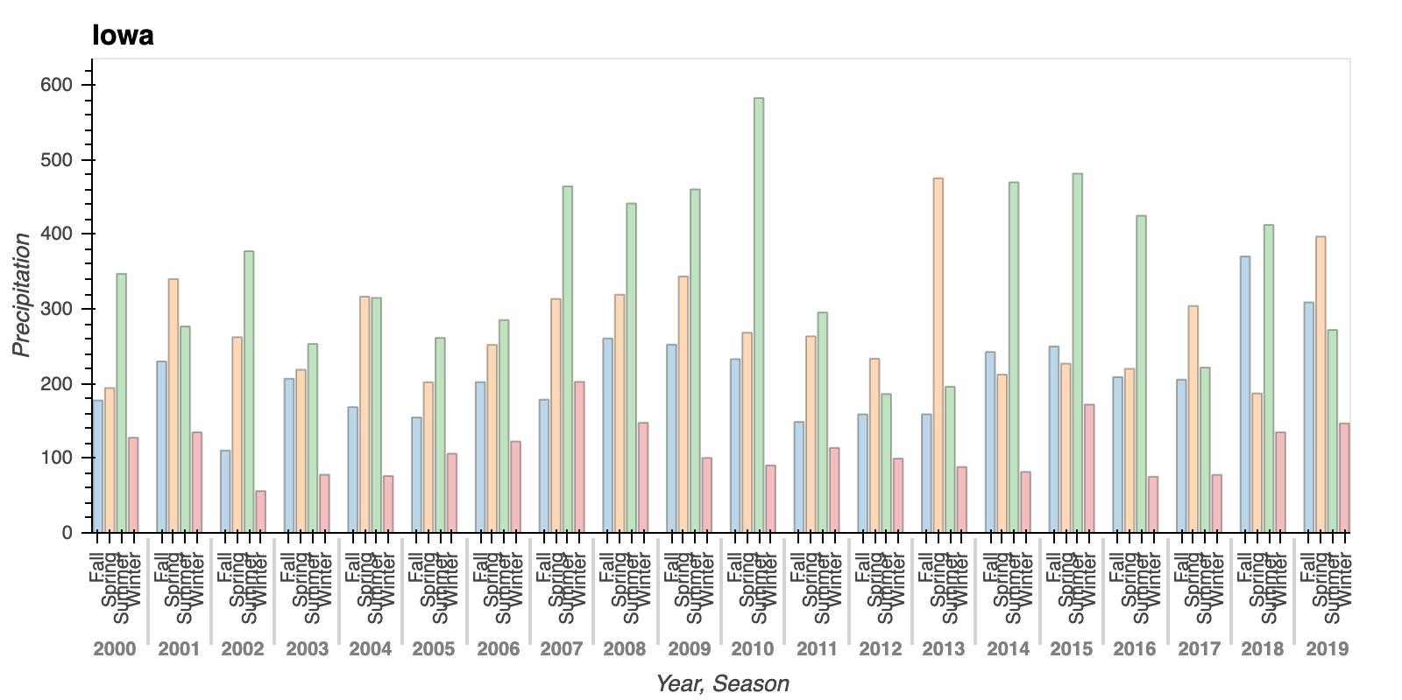
Weather analysis
Analysis:

Slide 9

Weather analysis
Dashboard

Slide 10

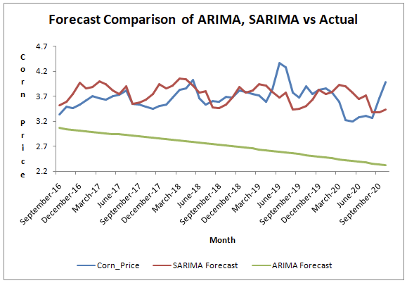
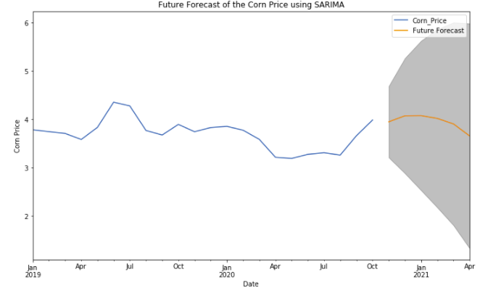
Time series analysis
Approach - using historical corn price to predict future price:
Time Series without seasonal impact (ARIMA)
Daily and monthly forecasting performed
Time series with seasonal impact (SARIMA)
Monthly forecasting using SARIMA
SARIMA - better performance due to inclusion of seasonality
Future forecast with SARIMA
Notes:
In order to forecast the corn price, we started with the univariate time series data i.e. with the historical corn price and applied Autoregressive Integrated Moving Average, or ARIMA method. Although the method can handle data with a trend, it does not support time series with a seasonal component. Therefore, we applied an extension to ARIMA that supports the direct modeling of the seasonal component of the series is called SARIMA. We used historical corn price data from January 2020 to October 2020 to these models.

Slide 11
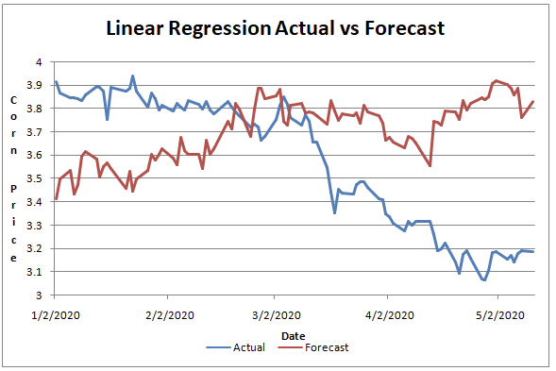
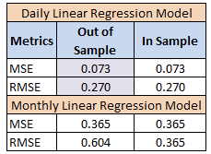
Linear regression analysis
Daily and monthly prediction using Linear regression using multiple features
Adding more features improved model performance, however the impact was seen due to market crash in Mar’20
Daily forecast of corn price used to build algo trading models

Slide 12
Machine learning - XGBoost
XGBoost used to validate assumptions:
Predicted corn price using weather data as feature
Predicted corn price using weather, ethanol and USD index as features
Results confirm that weather does not accurately predict the price of corn

Slide 13
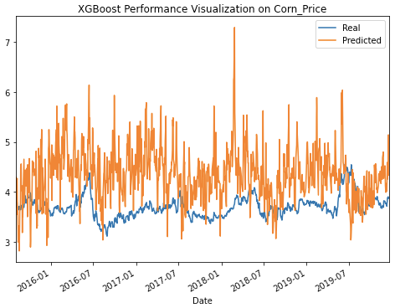
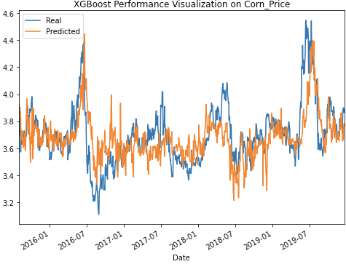
Machine learning - XGBoost
XGBoost with weather data only XGBoost with all data
dfsd
Median Average Error (MAE): 0.722
Median Average Error (MAE): 0.133

Slide 14
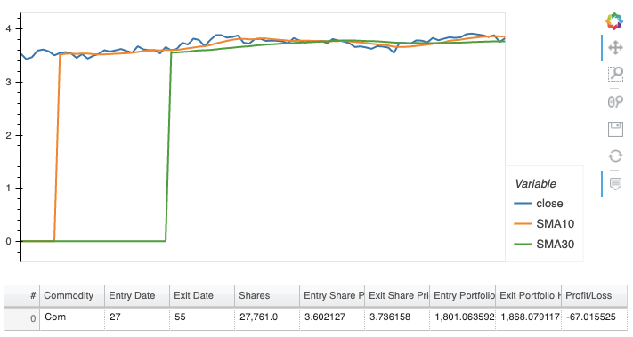
Algorithmic trading
Technical Indicator: Crossover between 10-day simple moving average (SMA10) and 30-day simple moving average (SMA30)
Signals:
Buy when SMA10 < SMA30
sell when SMA10 > SMA30
hold when SMA10 = SMA30

Slide 15
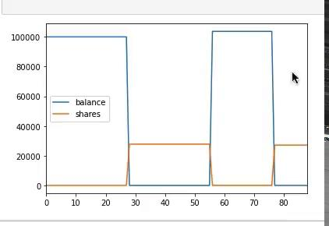
Algorithmic Trading
Trading Performance Evaluation:
Shares on Hold: 27132
Account Balance: $0.295
Account Total Monetary Value: $103968.4
Account Initial Capital: $100000

Slide 16
Summary of findings
1
3
Weather data cannot solely be used to predict corn price
You stand a chance to make money trading corn using our models!
2
Improved prediction of corn price when we include the macro-economic features in models
Notes:
Weather data cannot solely be used to predict corn price
Based on analysis, including the macro-economic factors in models, result in better prediction of corn price
You have a chance to make money trading corn using our models!

Slide 17
If we had more time..
Investigate Corn Yield as a feature
Additional weather metrics
Seasonality to only incorporate growing and harvesting months, when prices are volatile
Sentiment analysis - industry updates and news articles
Notes:
Investigate considering Corn Yield as a feature as this closer correlated to weather than corn price
Could have added additional weather metrics
Investigated and applied different approaches to seasonality to focus on incorporating growing and harvesting months, when prices are morevolatile
We could have considered adding a sentiment analysis by including industry updates and news articles

Slide 18
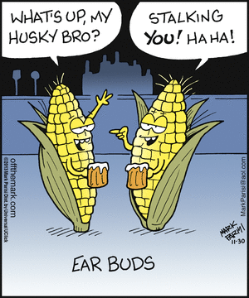
Questions
This presentation has been designed using resources from PoweredTemplate.com

